Slide 1
Machine Learning & Deep Learning
Week-16
Recurrent Neural Network (RNN)
Instructor: Engr. Najam Aziz
National Center for Big Data & Cloud Computing (NCBC), UET Peshawar

Slide 2
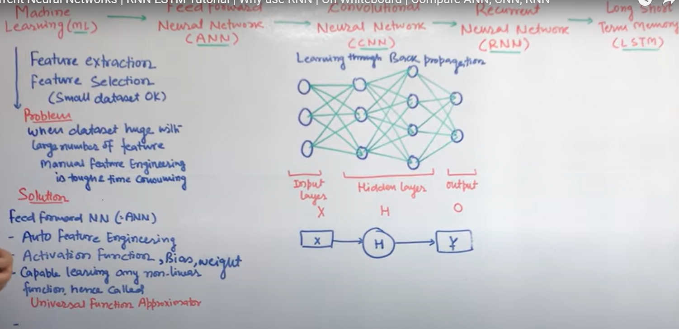

Slide 3
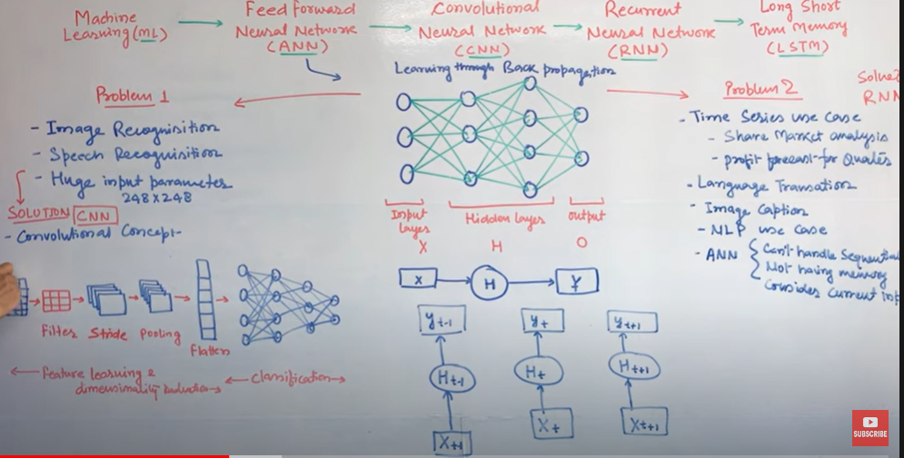

Slide 4
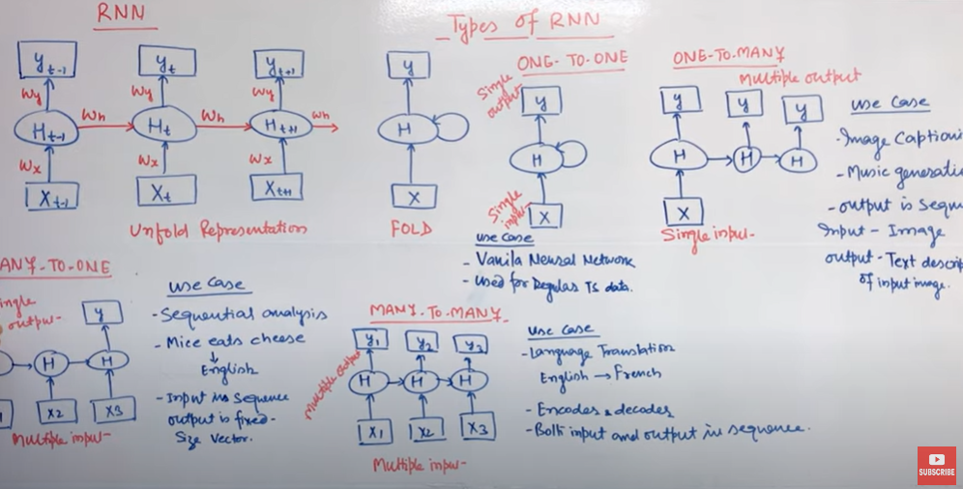

Slide 5
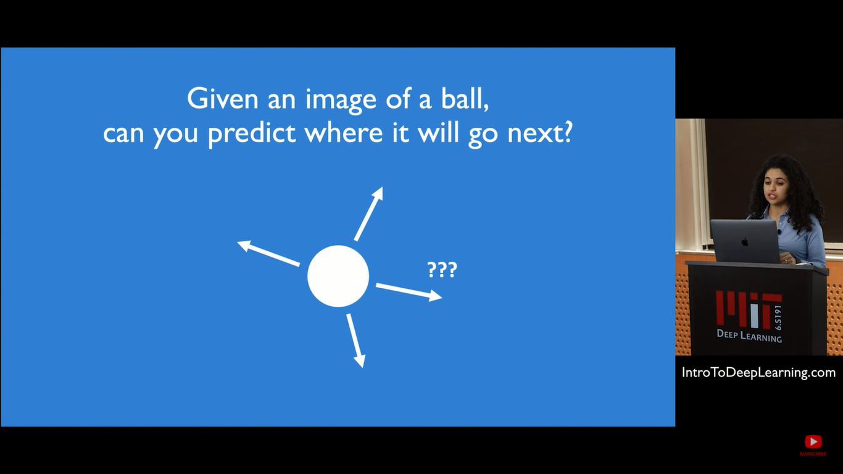
How Time/Temporal (history) information is useful

Slide 6
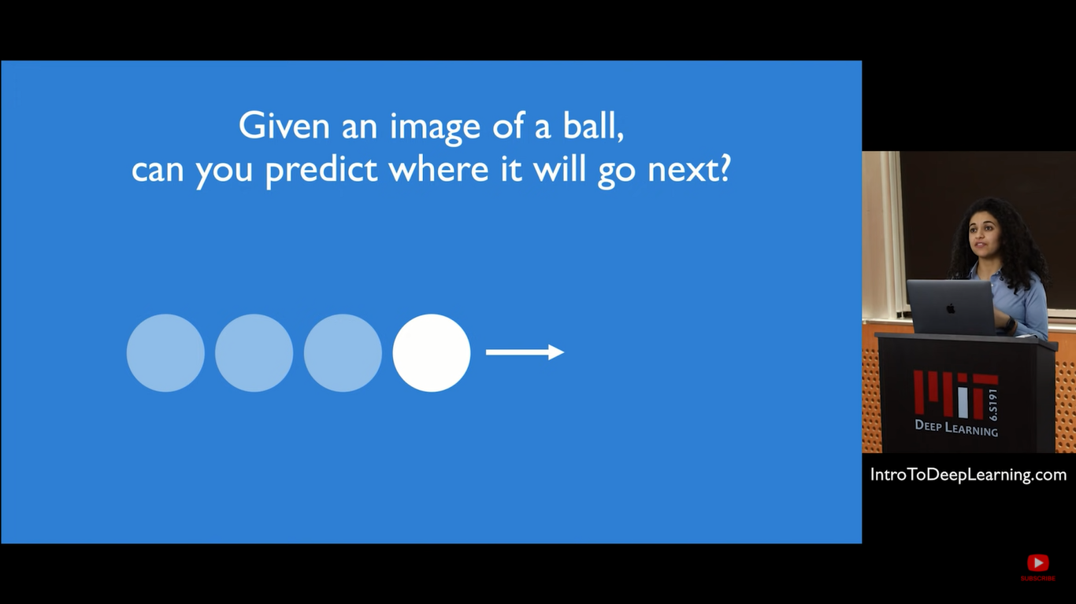

Slide 7
Data where the order matter in our ML space?
Text - Natural Language Data where the order of words matter
Speech data
Time series data
Video
Audio - Music Sequences data
Stock markets data
etc…

Slide 8
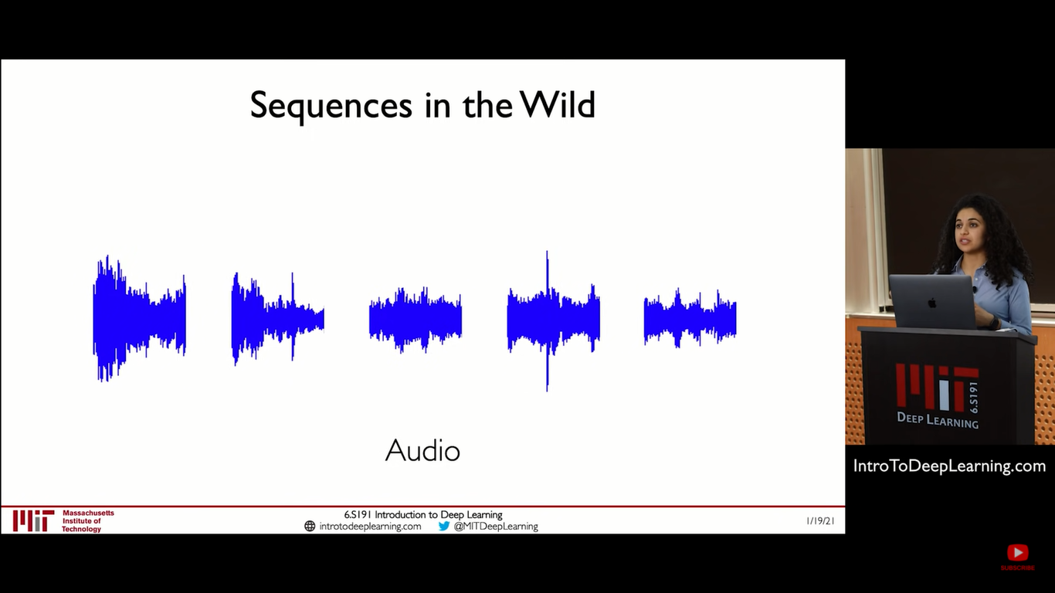

Slide 9
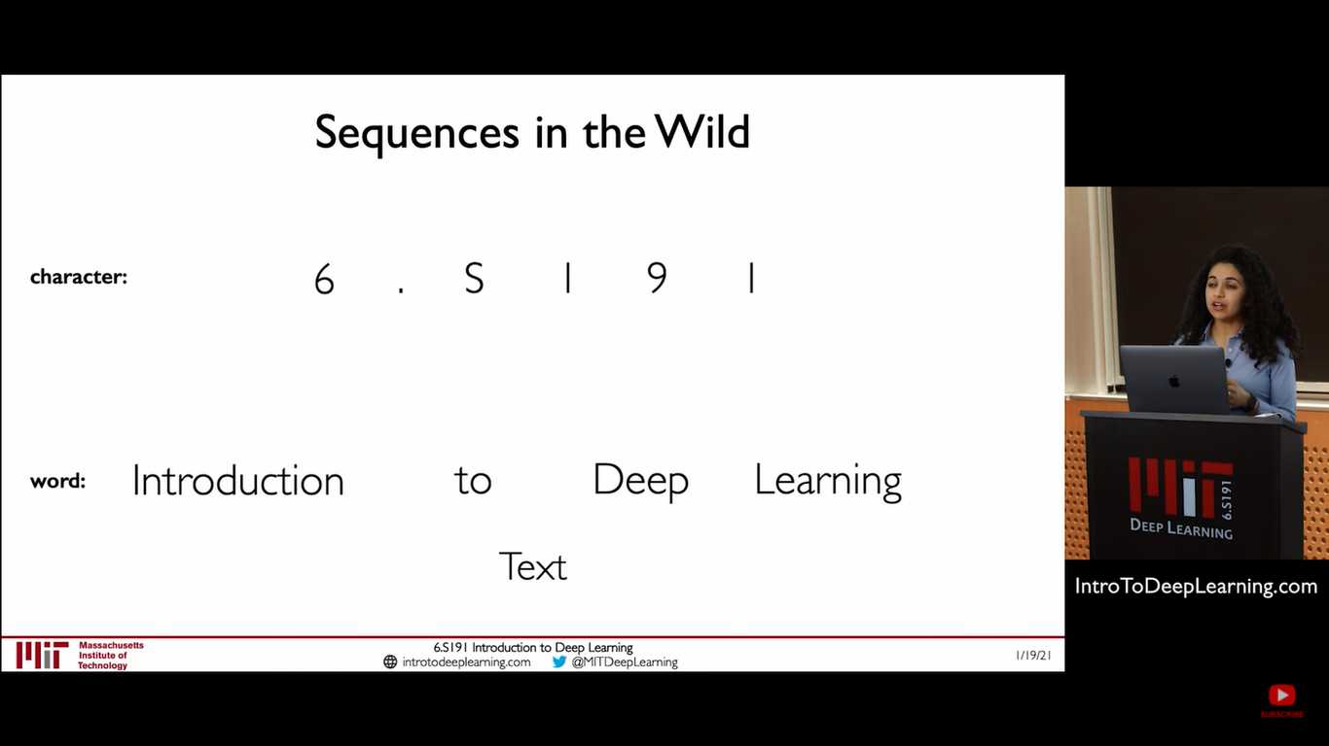

Slide 10


Slide 11
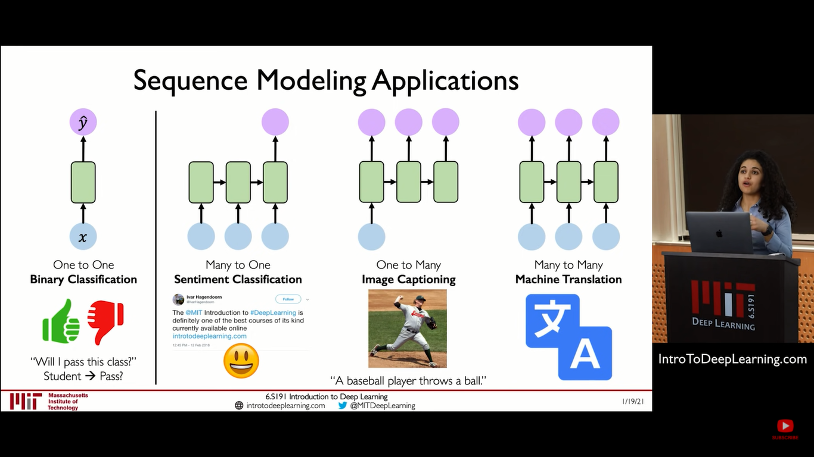

Slide 12
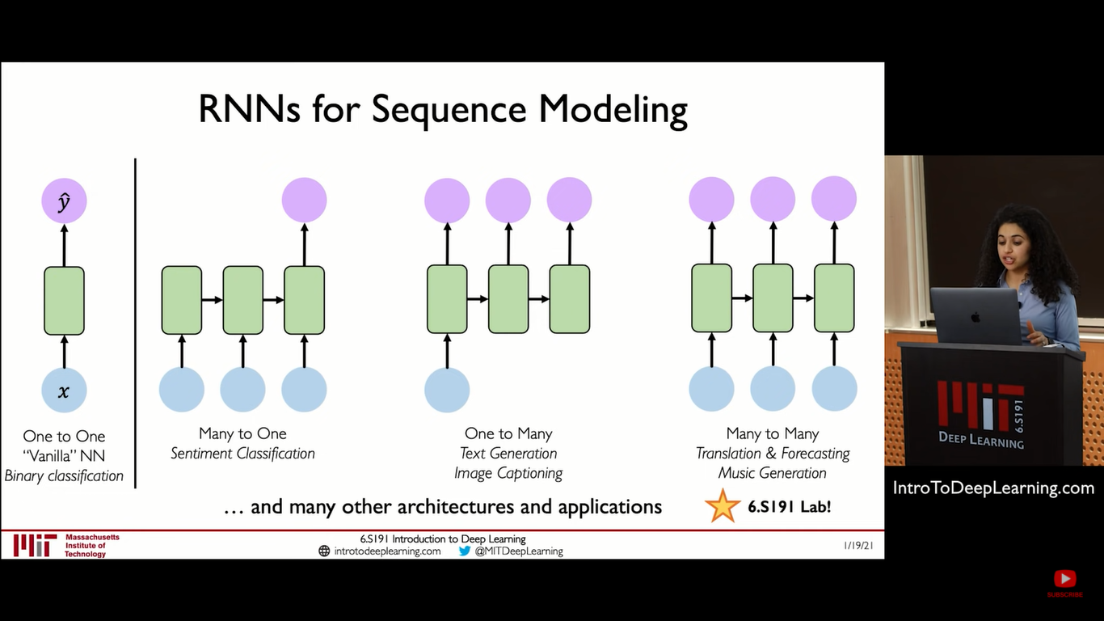

Slide 13
As the Order/Time/Temporal information is useful. So we need to embed the same intelligence into machines/model.
How?
Recurrent Neural Network

Slide 14
RNN

Slide 15
How RNN’s solve “the whole order matters thing” data?

Slide 16
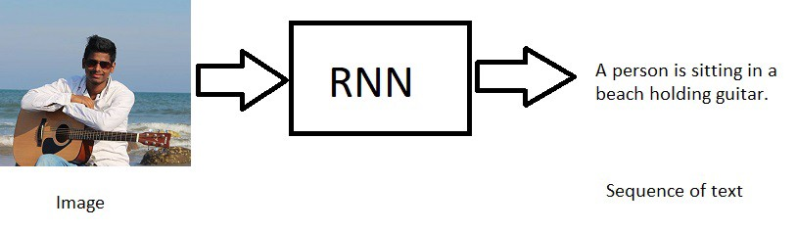
RNN has the following models
One to Many
RNN takes one input lets say an image and generates a sequence of words.

Slide 17
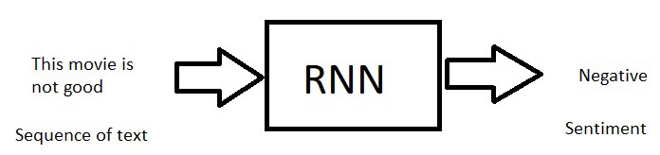
Many to One
RNN takes sequence of words as input and generates one output.

Slide 18
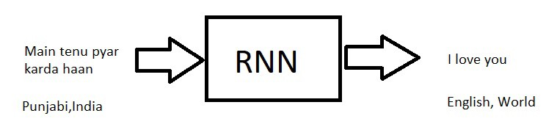
Many to Many
RNN takes sequence of words as input and generates sequence of words as output. (lets say language translations).

Slide 19
Why RNN? - What the Problem with ANN?
A neural network usually takes an independent variable X (or a set of independent variables ) and a dependent variable y then it learns the mapping between X and y (we call this Training), Once training is done , we give a new independent variable to predict the dependent variable.
In Fact that’s all most of machine learning(supervised).
but what if the order of data matters????? just imagine what if the order of all independent variables matter???
So a normal neural network does not follow the order, so when we tackle the real world problems where the order matters , we need Recurrent neural networks.

Slide 20
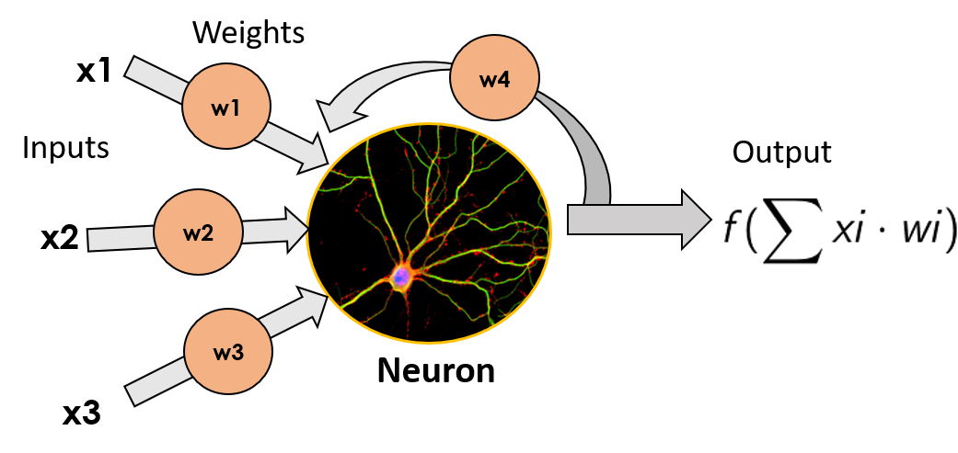
Neuron with Recurrence

Slide 21
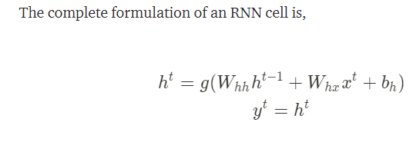

Slide 22
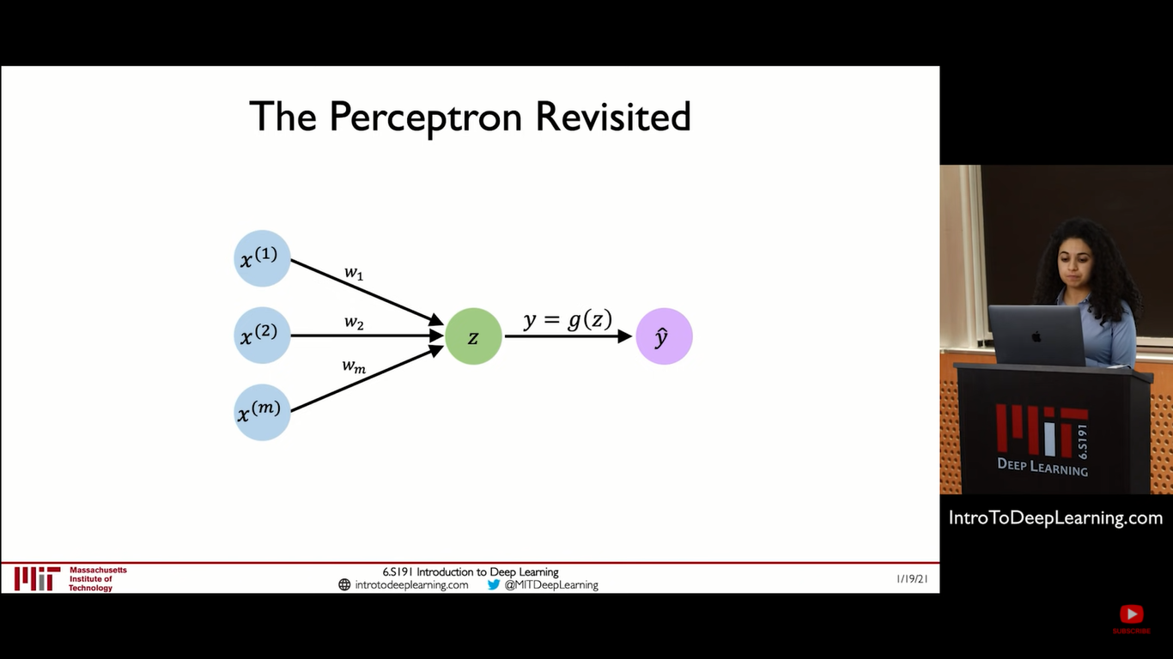

Slide 23
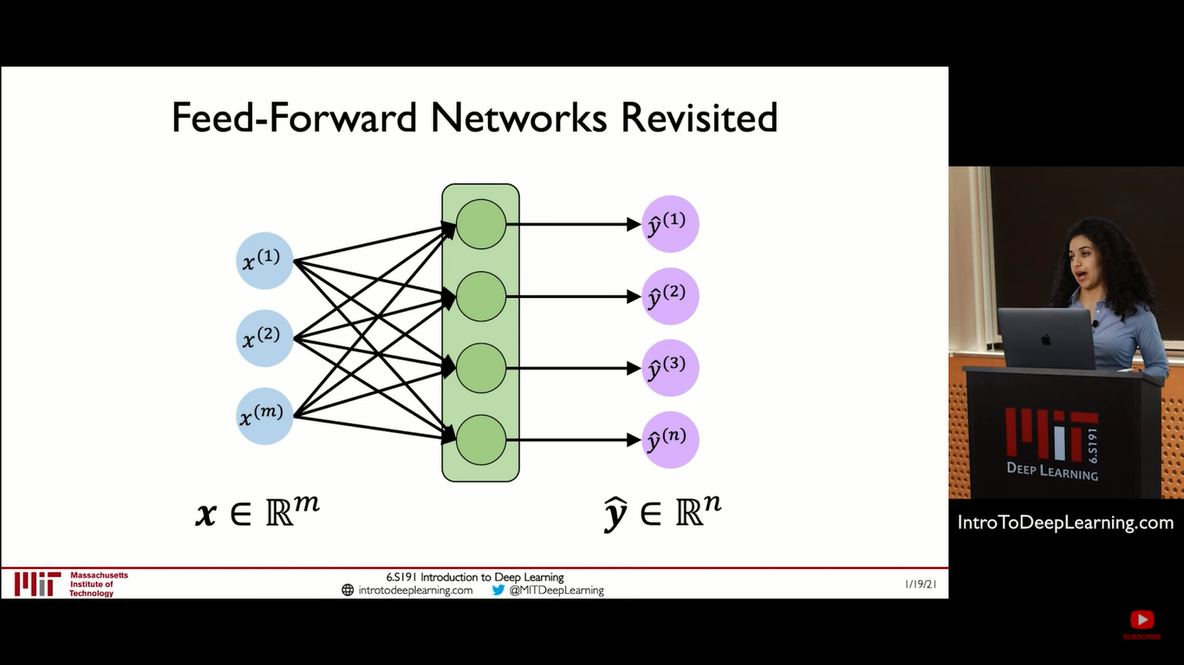

Slide 24
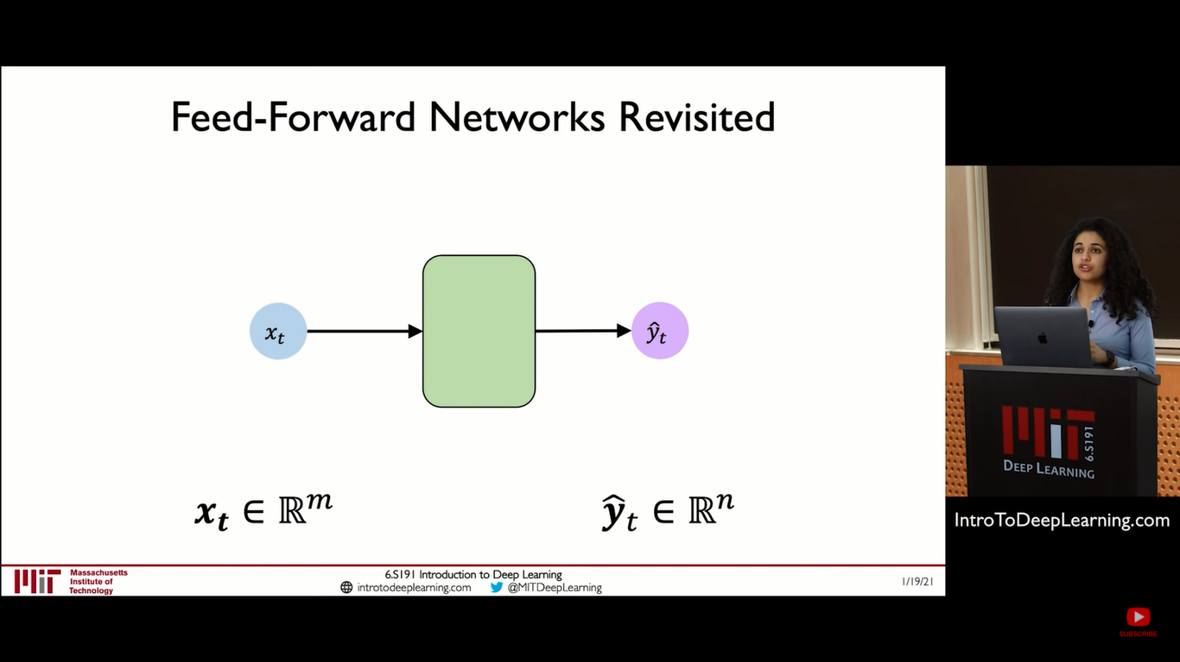

Slide 25
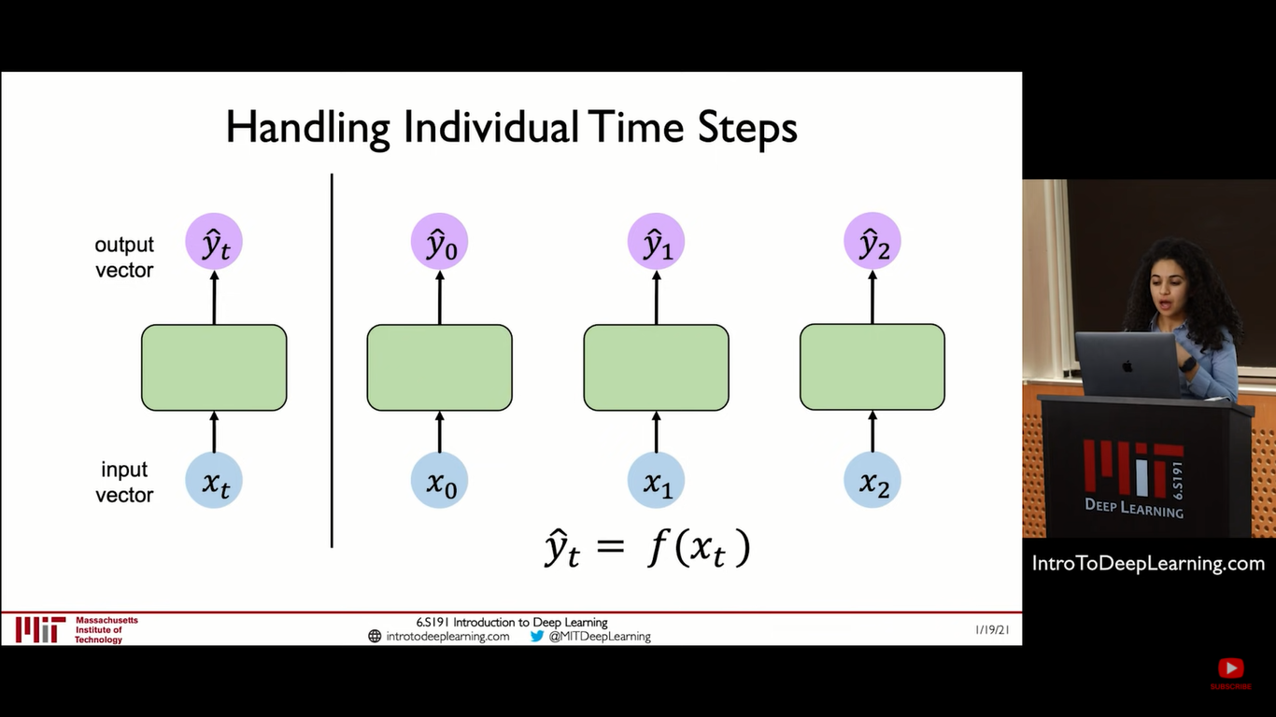

Slide 26
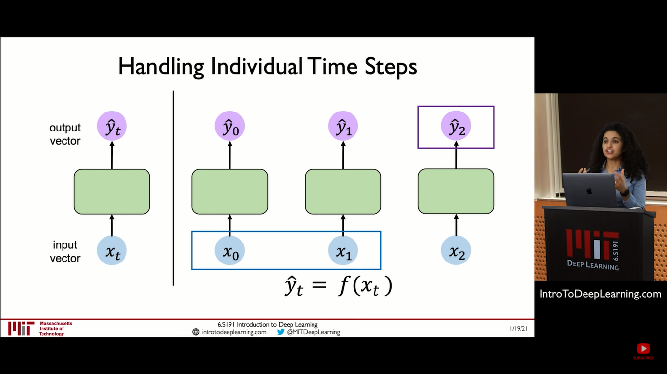
But what if i have Sequence/Order?

Slide 27
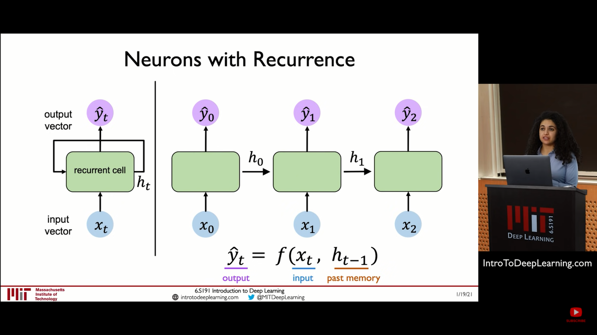

Slide 28
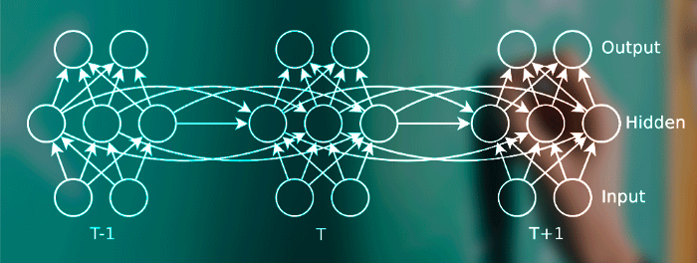

Slide 29
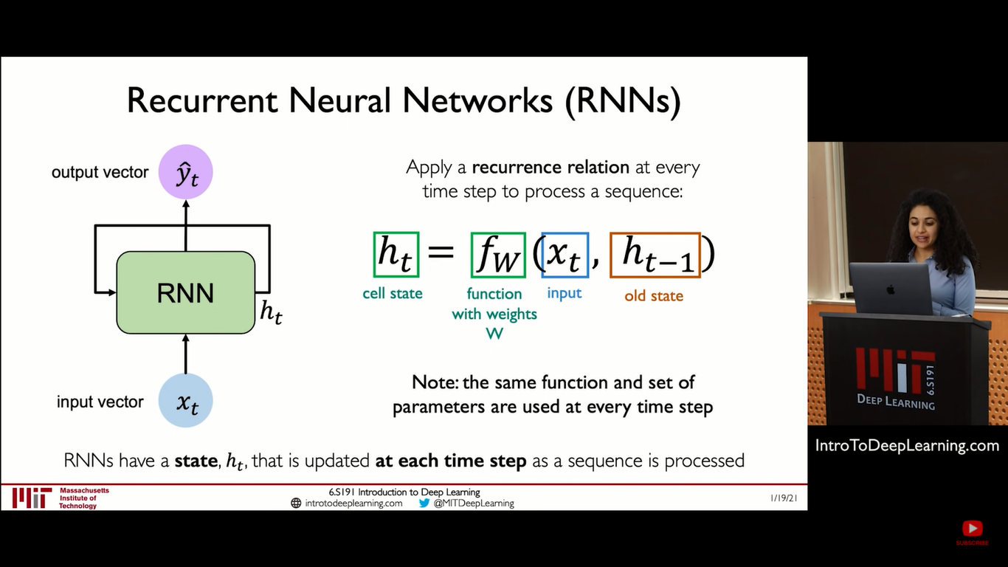

Slide 30
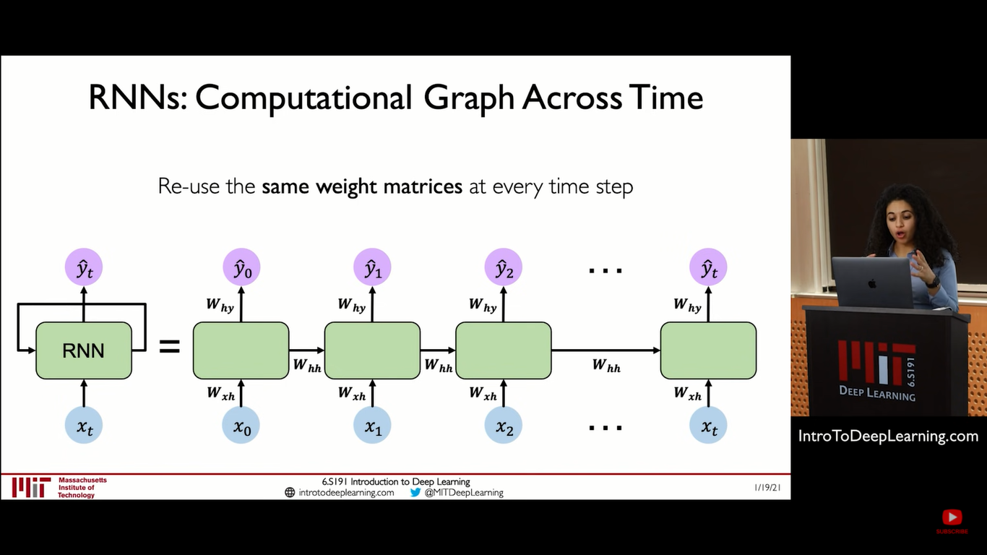

Slide 31
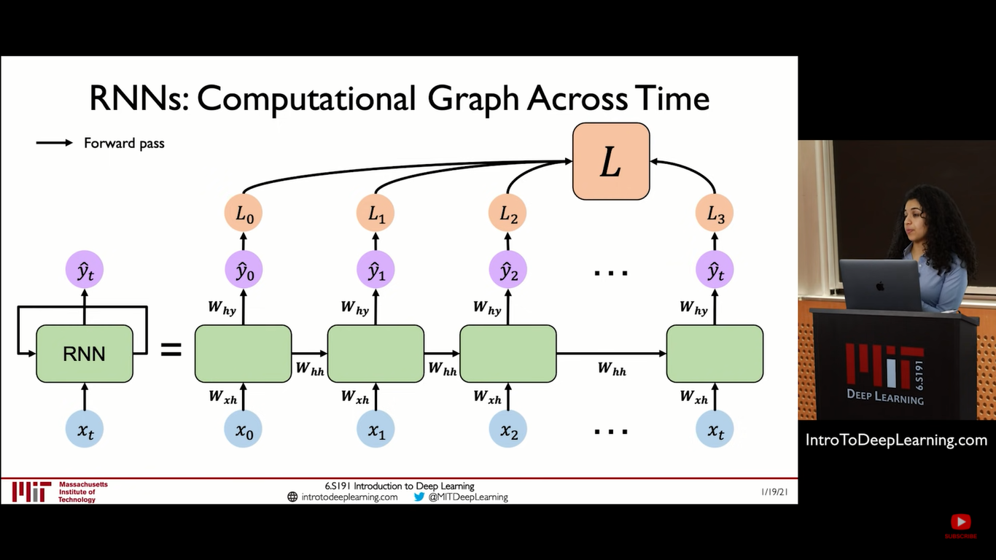

Slide 32
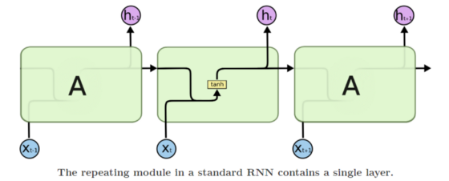
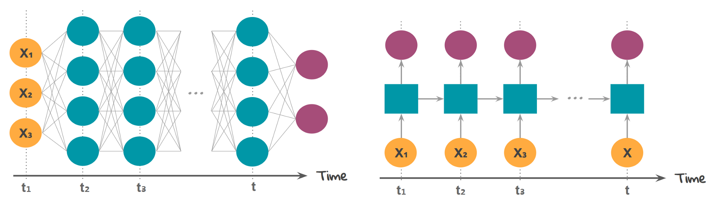

Slide 33
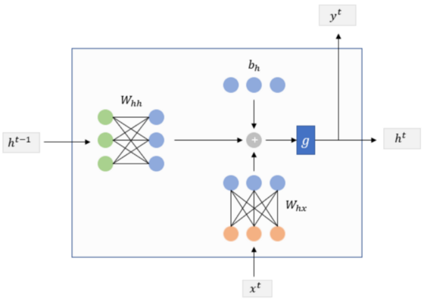

Slide 34
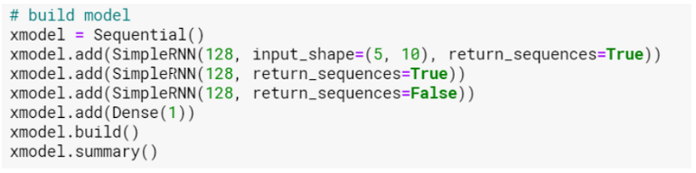
128 - Number of Hidden neuron 5 - Time Steps 10 - Number of Features

Slide 35
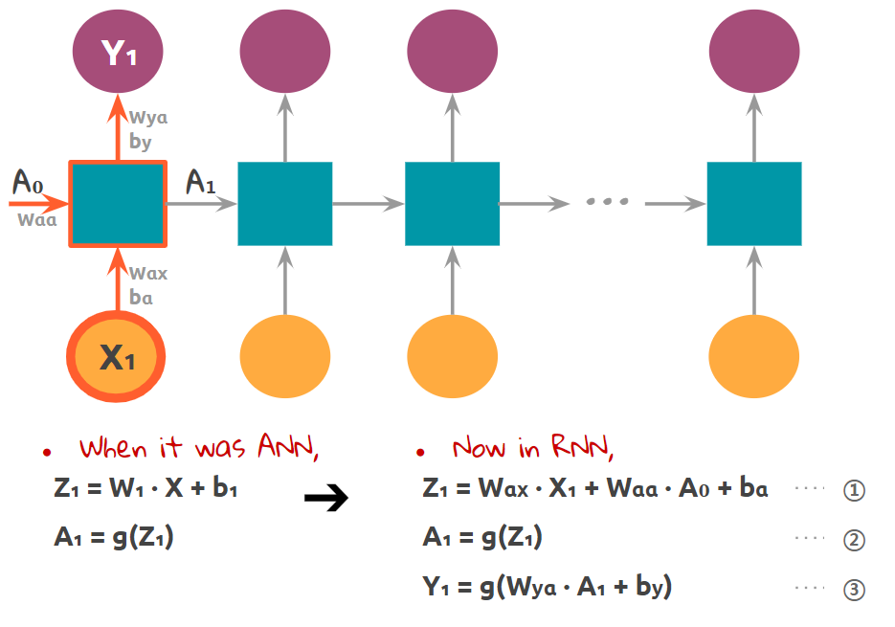

Slide 36
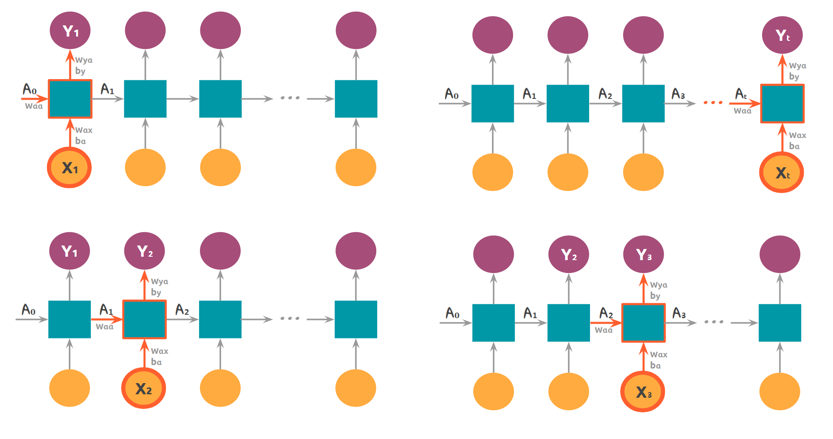

Slide 37
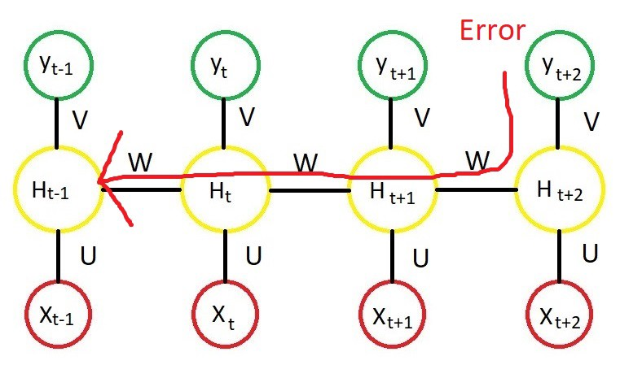
BPTT ( Back propagation through time )
We need to calculate the below terms how much does the total error change with respect to the output (hidden and output units) ? (or how much is a change in output) how much does the output change with respect to weights (U,V,W)? (or how much is a change in weights) Since W’s are same for all time steps we need to go all the way back to make an update.

Slide 38
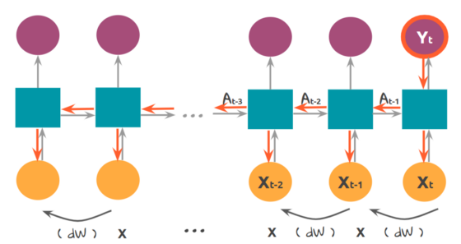
Problem with RNN
The idea of remembering the past is fantastic. But there is one critical problem in back-propagation. Back-propagation is a step for going backward to update the weights of each layer. To update the weights, we get the gradient of the cost function and keep multiplying the gradients at the given layers using chain rule. The actual backward propagation in RNN is a bit complex ( For example, The real backward propagation takes not only the final output Yt but also all the other output Y used by the cost function.)

Slide 39
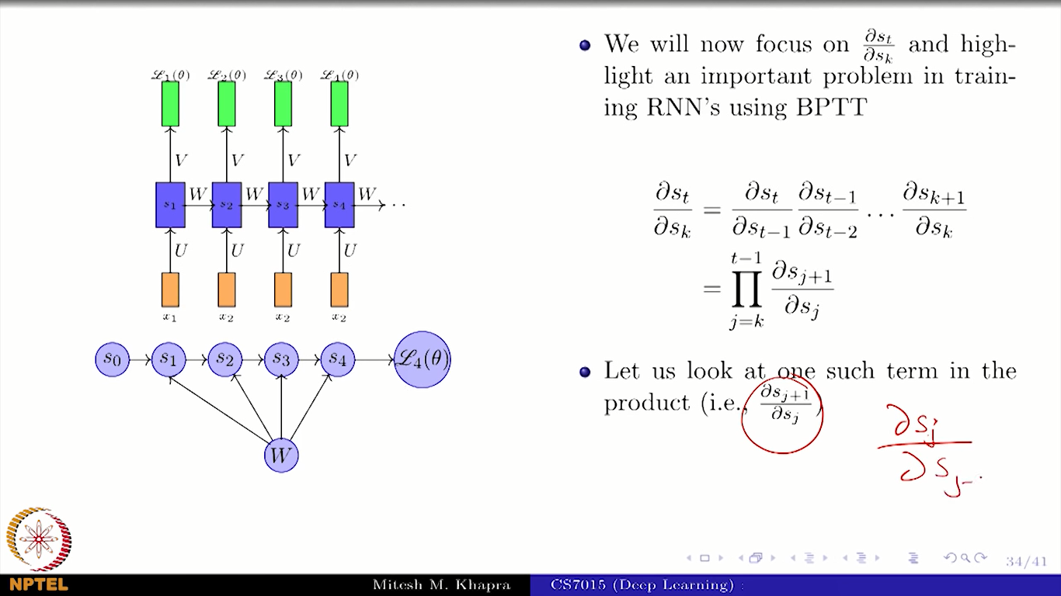

Slide 40
Exploding vs Vanishing Gradient
Imagine when the gradients are bigger than 1. The updated values become so big to use it for optimizing. This is called exploding gradients. But this isn’t a severe problem because we can fix the range that gradients can’t go over. The real problem occurs when the gradients are smaller than 1. If we keep multiplying the values lower than 1, the result becomes smaller and smaller. After some steps, there will be no significant difference in outcome, and it can’t make any update in weights. It is called vanishing gradients. It means the back-propagation effect can’t go far enough to reach the early stage of layers.
This is why people say RNN has a bad memory. If the length of the input values gets longer, we can’t expect actual optimization. This is a really critical problem because the power of neural networks comes from updating weights.
Solution: better to remember selectively (Choose only important information)

Slide 41
There are couple of remedies there to avoid this problem.
We can use ReLu unit as an activation function, RMS Prop as an optimization algorithm and LSTM’s or GRU’s.
so Lets focus on LSTM
https://medium.com/deep-math-machine-learning-ai/chapter-10-1-deepnlp-lstm-long-short-term-memory-networks-with-math-21477f8e4235

Slide 42
Other Solution: Selective Read, Write & Forget

Slide 43
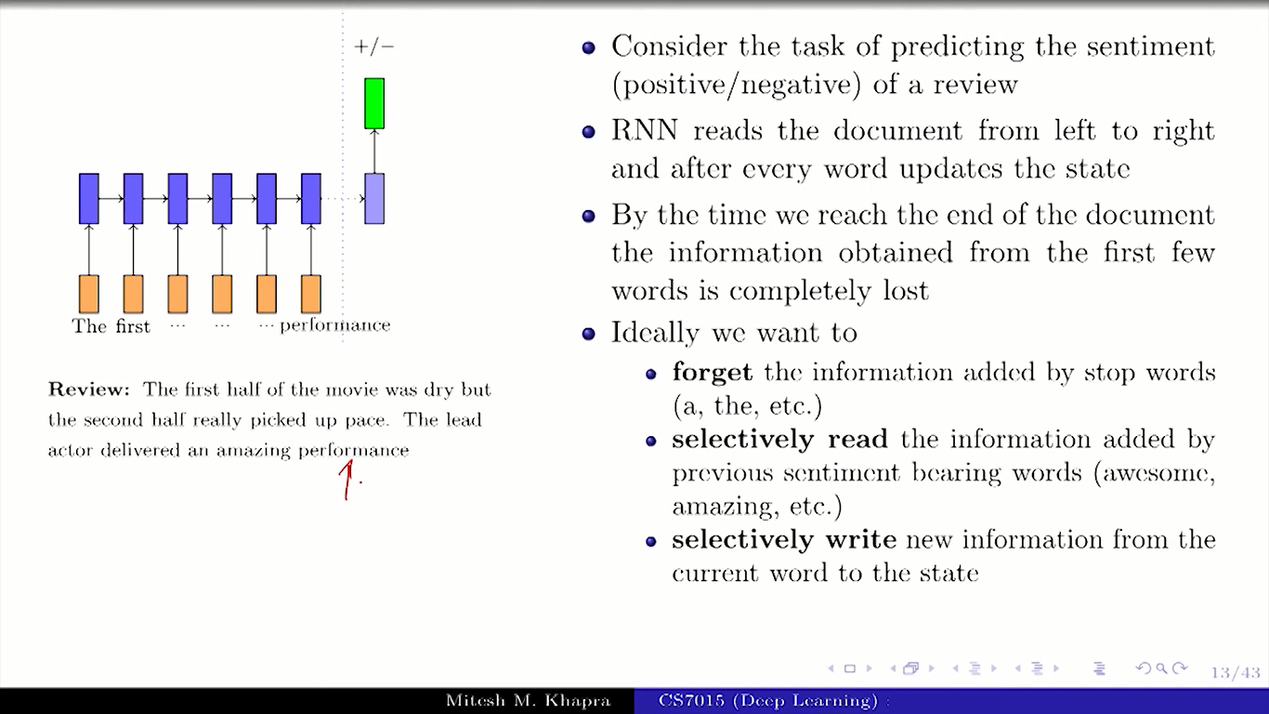

Slide 44
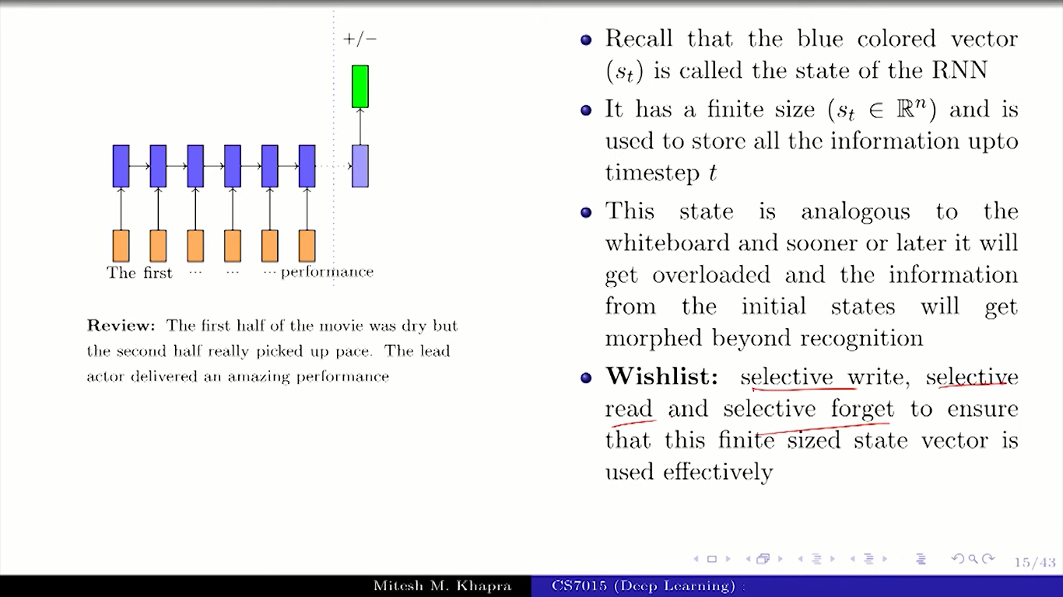

Slide 45
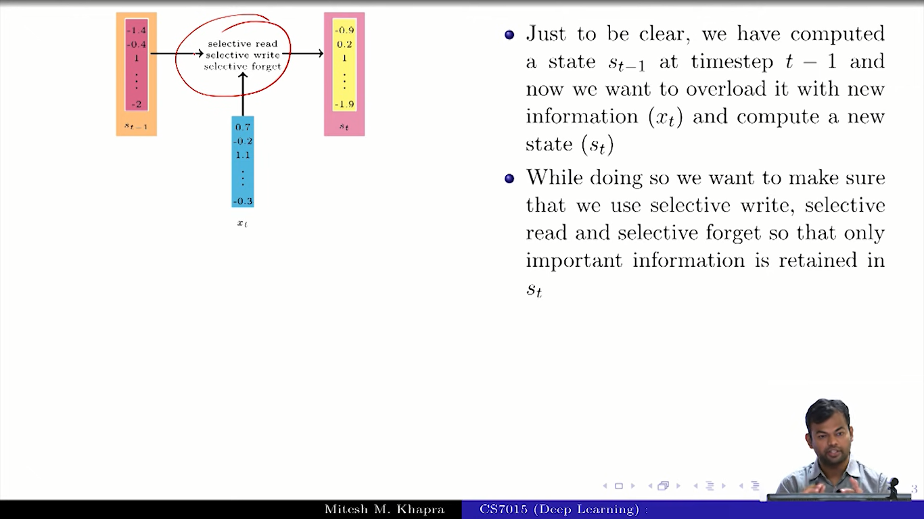

Slide 46
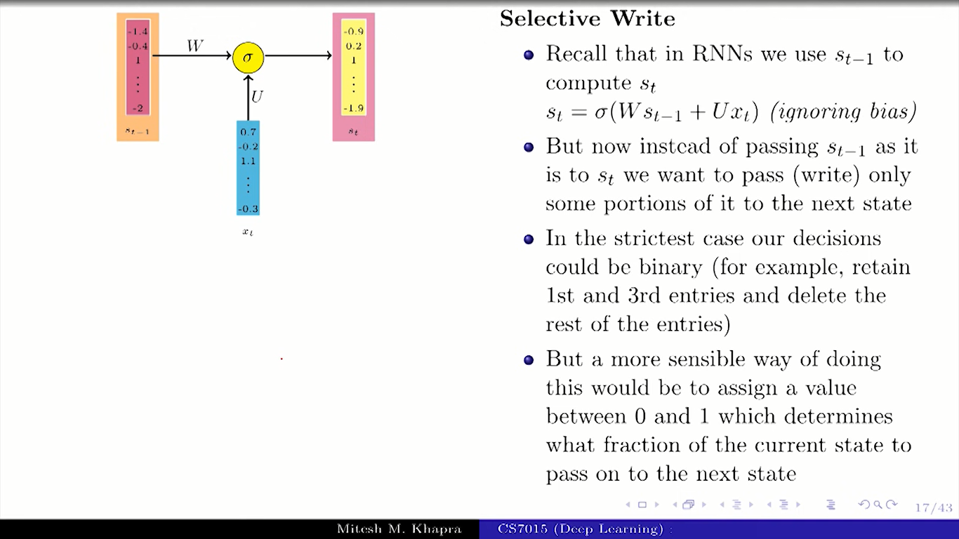

Slide 47
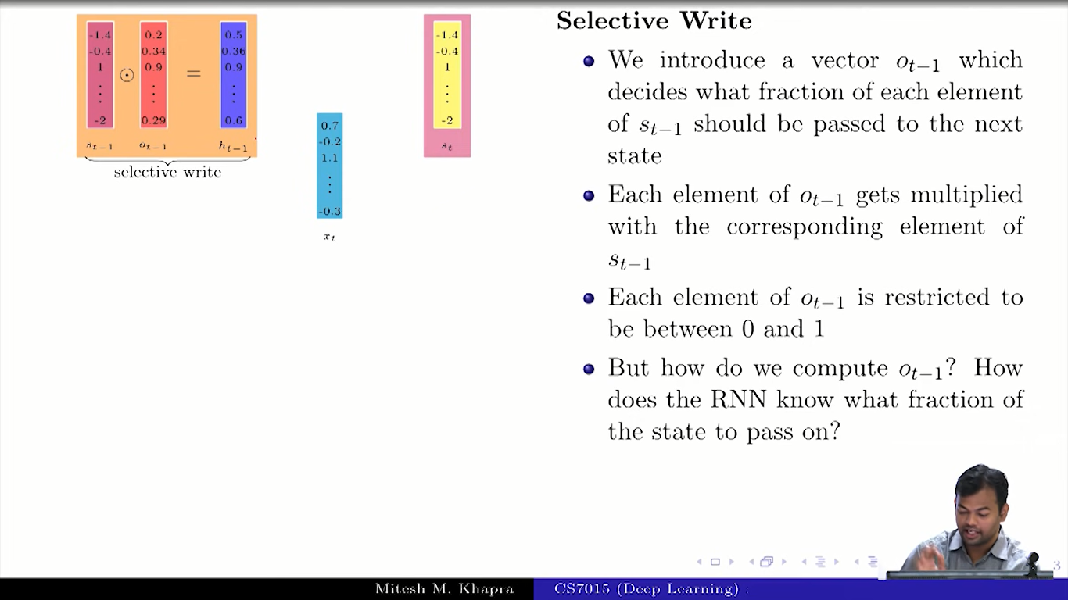

Slide 48
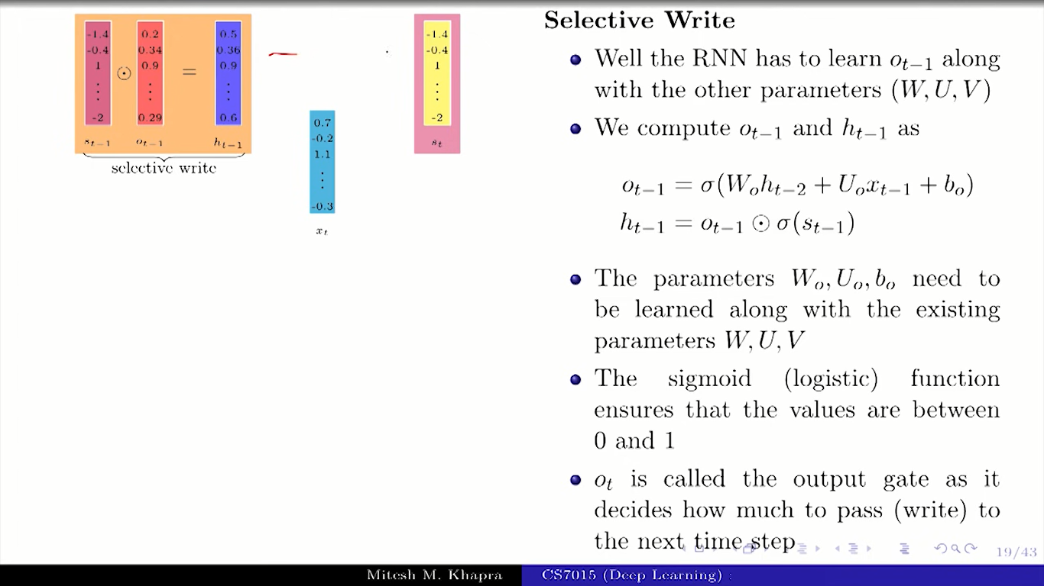

Slide 49
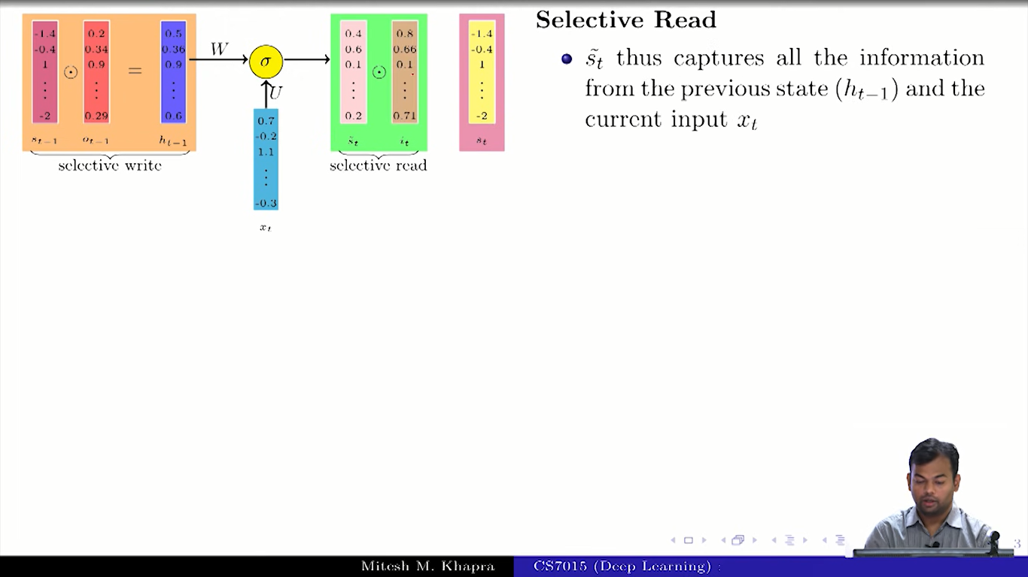

Slide 50
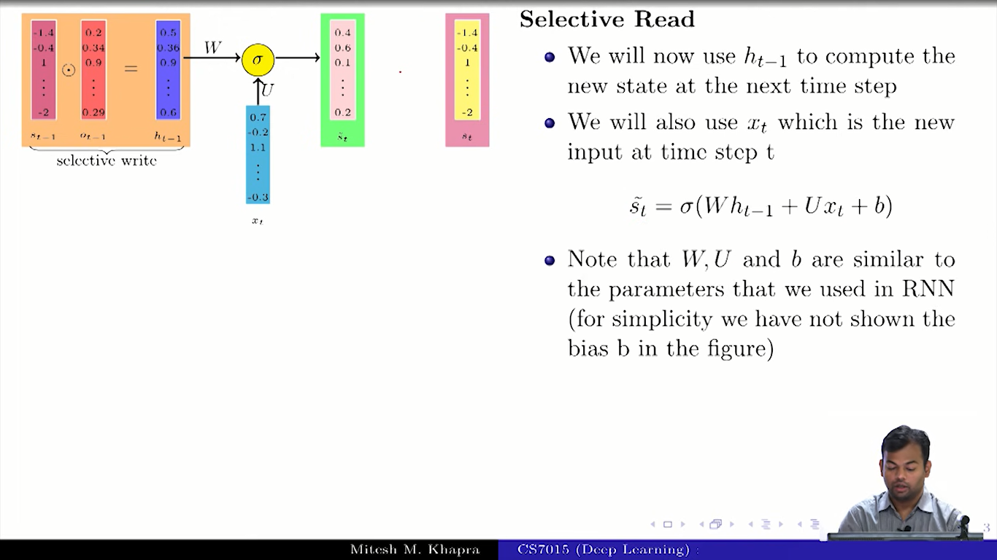

Slide 51
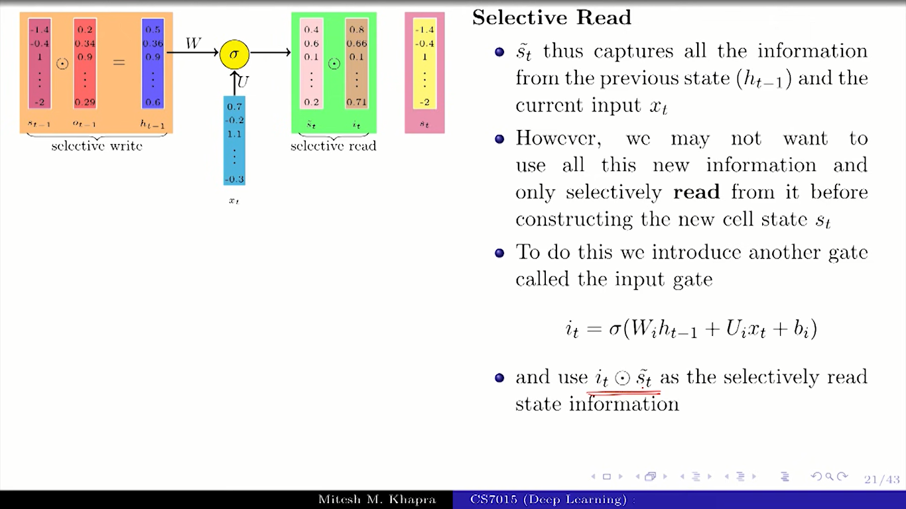

Slide 52
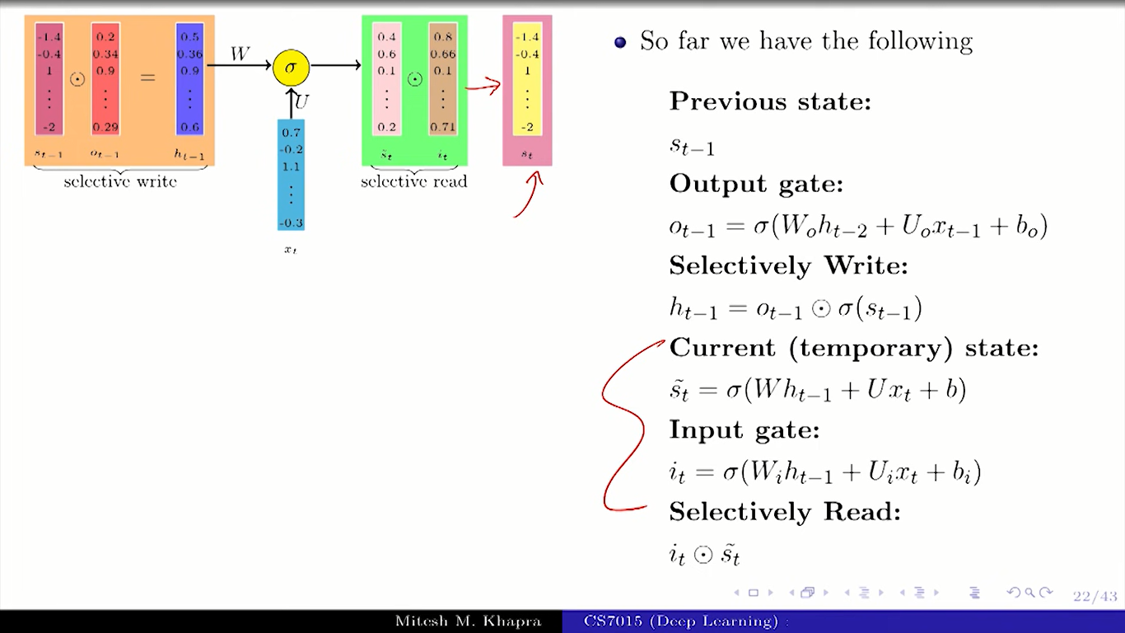

Slide 53
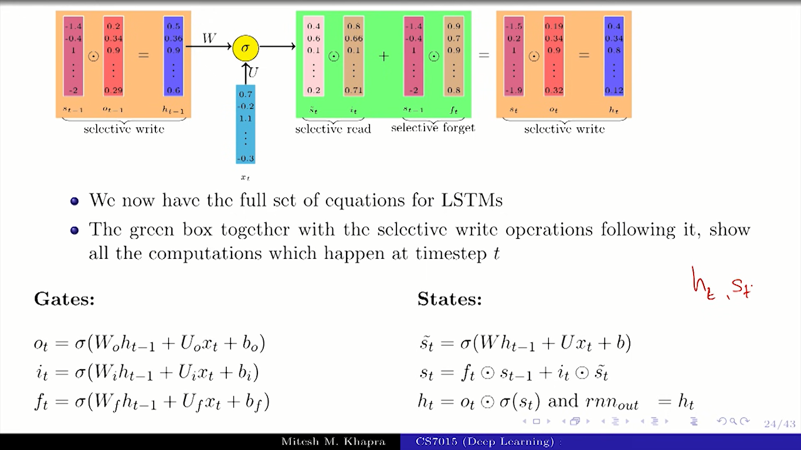

Slide 54
LSTM

Slide 55
LSTM
LSTM is a complex neural network block, used for modeling complex sequential data or time-series data.
LSTM is an improvement over RNN, which has the problem of vanishing/exploding gradients causing the inability to remember longer contexts in the sequential data.

Slide 56
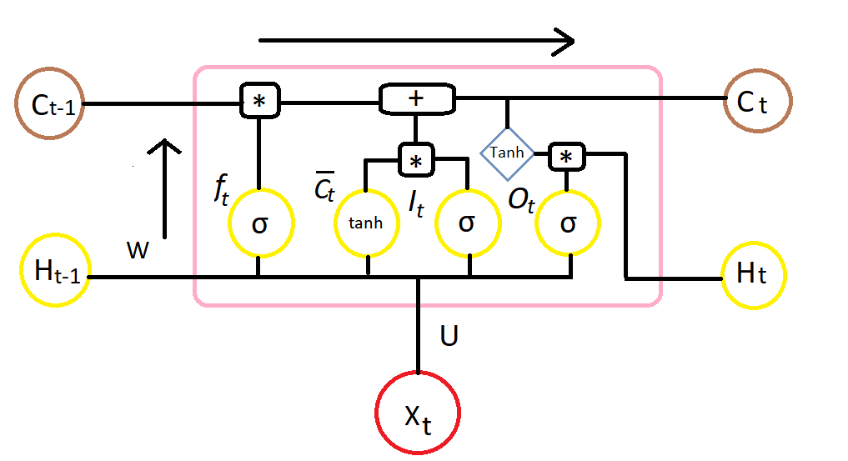
Here is the diagram for LSTM cell at the time step t

Slide 57
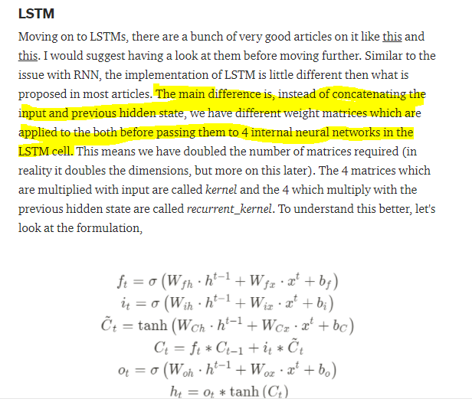

Slide 58
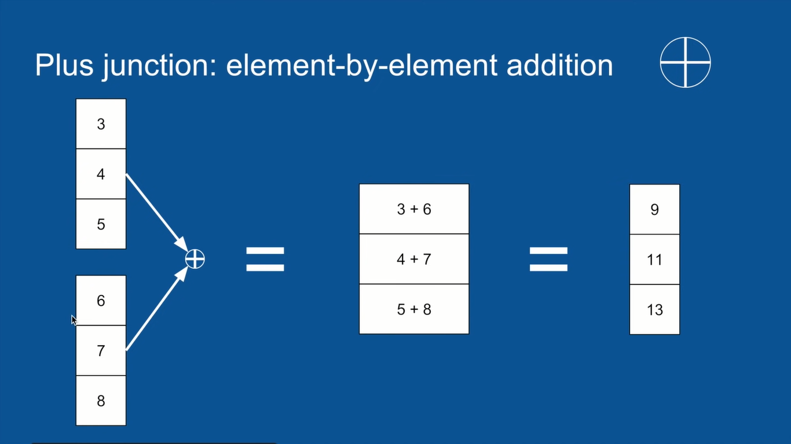

Slide 59
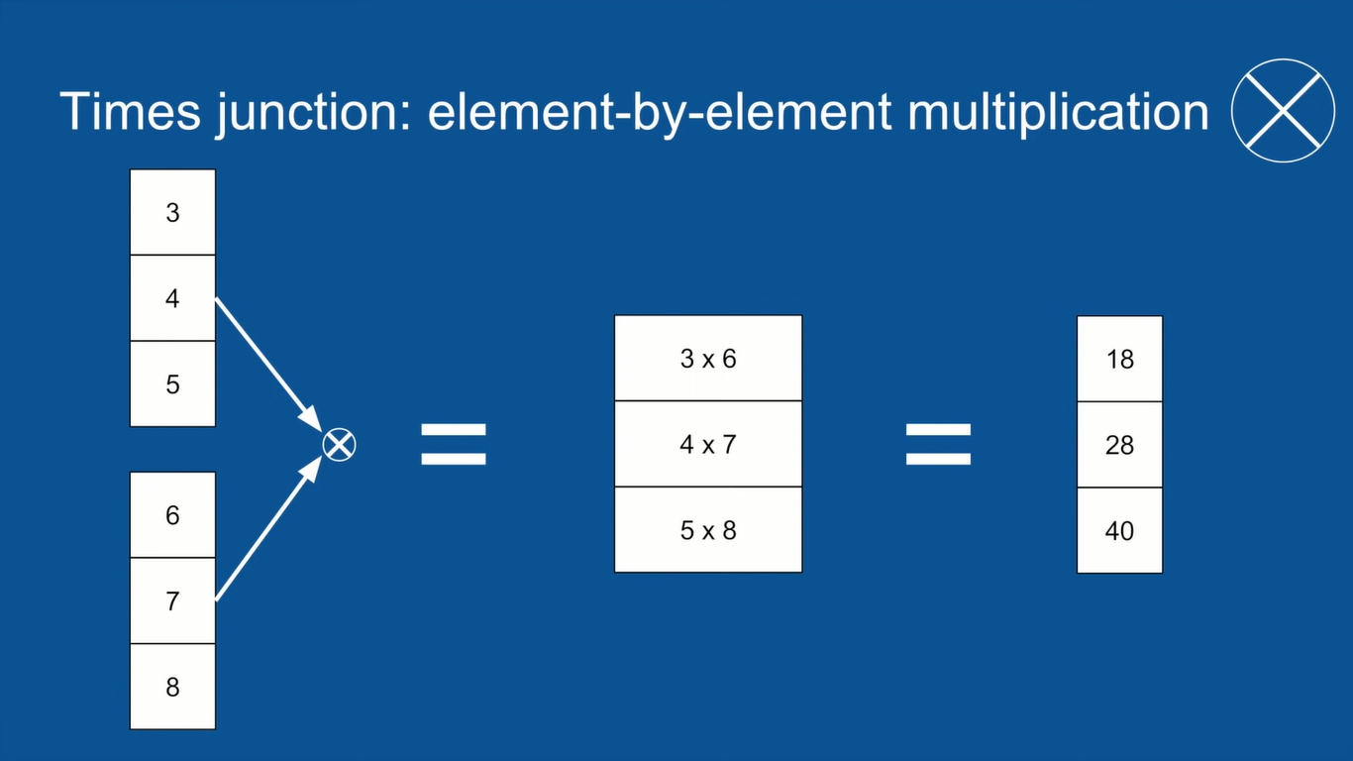

Slide 60
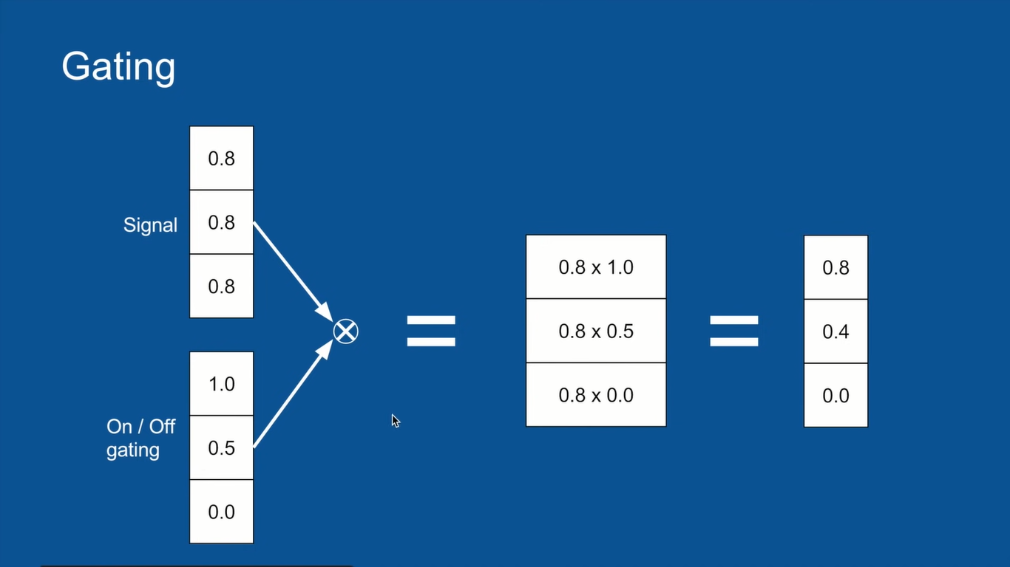

Slide 61
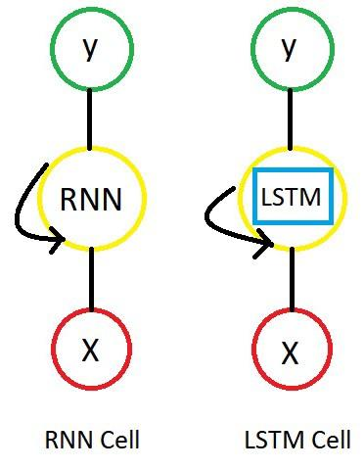
LSTM Cell
Just like RNN, we have time steps in LSTM but we have extra piece of information which is called “MEMORY” in LSTM cell for every time step.
So the LSTM cell contains the following components
Forget Gate “f” ( a neural network with sigmoid)
Candidate layer “C`"(a NN with Tanh)
Input Gate “I” ( a NN with sigmoid )
Output Gate “O”( a NN with sigmoid)
Hidden state “H” ( a vector )
Memory state “C” ( a vector)

Slide 62
What are the inputs and outputs of the LSTM cell at any step (time step (t))??
Inputs to the LSTM cell at any step are X (current input) , H ( previous hidden state ) and C ( previous memory state)
Outputs from the LSTM cell are H ( current hidden state ) and C ( current memory state)

Slide 63


Slide 64


Slide 65


Slide 66


Slide 67
How does the LSTM flow work??
If you observe carefully,the above diagram explains it all.
Anyway, lemme also try with words
Forget gate(f) , Candidate gate(C`), Input gate(I), Output Gate(O)
are single layered neural networks with the Sigmoid activation function except candidate layer( it takes Tanh as activation function)
These gates first take input vector.dot(U) and previous hidden state.dot(W) then concatenate them and apply activation function
finally these gate produce vectors ( between 0 and 1 for Sigmoid, -1 to 1 for Tanh) so we get four vectors f, C`, I, O for every time step.

Slide 68
Memory/Cell State
Now let me tell you an important piece called Memory state C. This is the state where the memory (context) of input is stored
Ex : Mady walks in to the room, Monica also walks in to the room. Mady Said “hi” to ____??
In order to predict correctly Here it stores “Monica” into memory C.
This state can be modified. I mean LSTM cell can add /remove the information.
Ex : Mady and Monica walk in to the room together , later Richard walks in to the room. Mady Said “hi” to ____??
The assumption I am making is memory might change from Monica to Richard.
I hope you get the idea.
so LSTM cell takes the previous memory state Ct-1 and does element wise multiplication with forget gate (f)
Ct = Ct-1*ft
if forget gate value is 0 then previous memory state is completely forgotten
if forget gate value is 1 then previous memory state is completely passed to the cell ( Remember f gate gives values between 0 and 1 )
Now with current memory state Ct we calculate new memory state from input state and C layer.
Ct= Ct + (It*C`t)
Ct = Current memory state at time step t. and it gets passed to next time step.

Slide 69

Finally, we need to calculate what we’re going to output. This output will be based on our cell state Ct but will be a filtered version. so we apply Tanh to Ct then we do element wise multiplication with the output gate O, That will be our current hidden state Ht.
Ht = Tanh(Ct)
We pass these two Ct and Ht to the next time step and repeat the same process. Here is the full diagram for LSTM for different time steps.

Slide 70

The blue box and the green box (the input gate) in the middle is the same with GRUs. There are two additional green boxes here: the forget gate and the output gate.
The computation will also be the same, so we’re going to get the output from the tanh function (①) and the input gate value from the sigmoid function (②). But the multiplying step is a bit different this time. Instead of taking only the result of the input gate, we also consider the forget gate value coming from the left.

Slide 71
Example - input output shape
Now I use Daniel Möller's example again for better understanding: We have 10 oil tanks. For each of them we measure 2 features: temperature, pressure every one hour for 5 times. now parameters are:
batch_size = number of samples used in one forward/backward pass (default=32) --> for example if you have 1000 samples and you set up the batch_size to 100 then the model will take 10 iterations to pass all of the samples once through network (1 epoch). The higher the batch size, the more memory space you'll need. Because the number of samples in this example are low, we consider batch_size equal to all of samples = 10
timesteps = 5
features = 2
units = It's a positive integer and determines the dimension of hidden state and cell state or in other words the number of parameters passed to next LSTM cell. It can be chosen arbitrarily or empirically based on the features and timesteps. Using more units will result in more accuracy and also more computational time. But it may cause over-fitting.
input_shape = (batch_size, timesteps, features) = (10,5,2)
output_shape:
(batch_size, timesteps, units) if return_sequences=True (batch_size, units) if return_sequences=False

Slide 72
Activation function used in RNN lstm
Sigmoid (for selective read, write and forget)--to have fraction of information
Tanh

Slide 73
Important Links and References - RNN_LSTM
https://www.youtube.com/playlist?list=PLyqSpQzTE6M9gCgajvQbc68Hk_JKGBAYT (Lecture_13-14)
https://bond-kirill-alexandrovich.medium.com/lstm-in-details-is-easy-501630afbcb9
https://medium.datadriveninvestor.com/recurrent-neural-network-rnn-52dd4f01b7e8
https://medium.com/@chunduri11/understanding-lstm-plain-and-simple-96026b4468c6
https://medium.com/@humble_bee/rnn-recurrent-neural-networks-lstm-842ba7205bbf
https://medium.com/@raqueebilahi/text-lstm-f1aaceeb5727
https://towardsdatascience.com/a-practical-guide-to-rnn-and-lstm-in-keras-980f176271bc
https://developer.ibm.com/articles/cc-cognitive-recurrent-neural-networks/
https://stackoverflow.com/questions/44273249/in-keras-what-exactly-am-i-configuring-when-i-create-a-stateful-lstm-layer-wi
https://stats.stackexchange.com/questions/365428/difference-between-a-single-unit-lstm-and-3-unit-lstm-neural-network/365600
https://www.youtube.com/watch?v=9TFnjJkfqmA
https://www.ssla.co.uk/long-short-term-memory/

Slide 74
Xtra

Slide 75


Slide 76

Gated Recurrent Units (GRU)
Instead of dragging all the past, maybe it’ll be better to remember selectively. This is like choosing only the important information and forgetting the rest. Having all those past values causes the vanishing gradients. Therefore we’ll give an additional step to simple RNN, which is called Gated Recurrent Units.
On the right side, you can see one small change inside the box. The green box. What is this? This is a gate controller. This box determines whether we should remember or not.

Slide 77

We’ll compute the tanh activation (①) as what we did with RNN, but this won’t be used right ahead. It’s like a candidate. Here we’ll also get the new value (②) for the gate. Since it takes the sigmoid function, the output value always goes between 0 to 1. So by multiplying it with the ① value, we’re going to decide whether we’ll use it or not. When it’s 0, “No Use” or “No Update.” (Use the previous value in this case) When it’s 1, “Use” or “Update.” This is like opening and closing a gate.

Slide 78
Long Short Term Memory Network (LSTM)
LSTM was proposed earlier than GRUs.
Structure of LSTM is more complex compared to that of GRUs with two more gates.
Additionally, there will be a new concept here which is called ‘cell state.’ But you’re already used to this concept. It’s putting the value containing the memories aside from the hidden state value A.

Slide 79

Let’s see the equation in line 3 on the right. We have the forget gate, and this will be used for updating the cell state value like what you can see in line 4. Lastly there is one gate left, the output gate. And as you can see in line 6, we get the A value at time t by multiplying the output gate value and the tanh activation value of C at time t.

Slide 80
With these three additional gates, LSTM can have a stronger memory ability. Those are all about controlling which parts or what amount it should remember. It’s so robust and effective that it’s really popular among the sequence models. Then could we say is it better than GRUs for all cases? As we say there’s no silver bullet all the time, GRUs has its own strength as well. Its structure is simpler than LSTM, so it’s sometimes proper to use GRUs to make a big model.

Slide 81

Conclusion
What we’ve discussed so far was the sequence model with one shallow layer. Then what it would be like when we add more layers? If we say adding more layers goes horizontal in ANN or CNN, it goes vertically in RNN.
But the sequence model is already a big model with one or two layers, it may end up overfitting if we add a few more layers on top of that. Therefore applying normalization techniques such as dropout or batch normalization is required.

Slide 82
The short-term memory issue for vanilla RNN’s doesn’t mean to skip them entirely and use the more evolved versions like LSTM’s or GRU’s. RNN’s have the benefit of training faster and uses less computational resources. That’s because there are fewer tensor operations to compute. You should use LSTM’s or GRU’s when you expect to model longer sequences with long-term dependencies.

Slide 83
Currently we are focusing on 2nd model “Many to One”.
in RNN’s Input is considered as time steps.
ex : input(X) = [“this”, “movie”, “is”, “not”, “good”]
Time stamp for “this” is x(0), “movie” is x(1), “is” is x(2) ,“not” is x(3) and “good” is x(4).
First let’s understand what RNN cell contains!

Slide 84

Summary of FFNN is

Slide 85
In Feed forward neural network we have X(input) and H(Hidden) and y(output)
you can have as many hidden layers as you want but weights (W)for every hidden layers are different.
Above Wh1 and Wh2 are different.
The RNN cell contains a set of feed forward neural networks cause we have time steps.
The RNN has: sequential input, sequential output, multiple timesteps, and multiple hidden layers.
Unlike FFNN , here we calculate hidden layer values not only from input values but also previous time step values and Weights ( W ) at hidden layers are same for time steps.

Slide 86
In the picture we are calculating the Hidden layer time step (t) values so
Ht = Activatefunction(input * Hweights + W * Ht-1)
yt = softmax(Hweight* Ht)
Ht-1 is the previous time step and as i said W’s are same for all timesteps.
The activation function can be Tanh, Relu, Sigmoid, etc..

Slide 87
Above we calculated only for Ht similarly we can calculate for all other timesteps.
Steps:
Calculate Ht-1 from U and X
Calculate yt-1 from Ht-1 and V
Calculate Ht from U,X,W and Ht-1
Calculate yt from V and Ht and so on…
Note :
1.U and V are weight vectors, different for every time step.
2.We can even calculate hidden layer( all time steps ) first then calculate y values.
3. Weight vectors are random initially.
Once Feed forwarding is done then we need to calculate the error and backpropagate the error using back propagation.
we use Cross entropy as cost function ( assume you know so not going into details)

Slide 88

Here is the complete picture for RNN and it’s Math.

Slide 89

Remember the BP for RNN is as same as neural networks BP. but here Current time step is calculated based on the previous time step so we have to traverse all the way back. if we apply chain rule which looks like this
W’s are same for all the time steps so the chain rule expands more and more

Slide 90
Problems with RNN → Vanishing/exploding gradient problem
Since W’s are same for all timesteps, during back propagation as we go back adjusting the weights, The signal gets either too weak or too strong which cause either vanishing or exploding problem.
To avoid this we use either GRU or LSTM

Slide 91

We all know that a neural network uses an algorithm called BackPropagation to update the weights of the network. So what BP does is
It first calculates the gradients from the error using the chain rule in Calculus, then it updates the weights(Gradient descent).
since the BP starts from the output layer to all the way back to input layer , In a simple neural network we may not face problems with updating weights but in a deep neural network we might face some issues.

Slide 92
As we go back with the gradients , It is possible that the values get either smaller exponentially which causes Vanishing Gradient problem or larger exponentially which causes Exploding Gradient problem.
Due to this we get the problems of training the network.
In RNN’s, we have time steps and current time step value depends on the previous time step so we need to go all the way back to make an update.

Slide 93


Slide 94


